Slide 1


FIFA DATASET 2022
DATA ANALYSIS ON
Let’s go deep in the game now!

Slide 2

OBJECTIVE
Here in my project , I am about to analyze the available “FIFA Dataset” . My aim is to find whether there is any direct or indirect relationship between Physical and Mental attributes defined by the data.
Plots of different variable values will give the idea about the nature of them. My dataset has a mix of numerical and categorical data. So my objective is to establish the conclusion based on the results on a few statistical analysis such as MULTIVARIATE REGRESSION ANALYSIS : creating models , check ANOVA among them , whether the models are appropriate or not (using assumptions).
The purpose of this analysis is to imply proper understanding of data handling of Football and inference properly about the characteristics .

Slide 3
TABLE OF CONTENTS
FIFA RATING SYSTEM
MULTIPLE REGRESSION
01
03
DESCRIPTIVE PART
HYPOTHESIS TESTING
02
04
How well the system is used in computing !
Use the regression with suitable assumptions and interpret
Some basic plots and idea about the whole dataset
Test the hypothesis about models constructed

Slide 4
EXTRA ANALYSIS AND CONCLUSIONS USING DATA SORTING AND PLOTTING

Slide 5
FOUR ‘S’ IN FOOTBALL
STRENGTH
STAMINA
SKILL SPEED
But what about the psychological aspects ? Do the Free-kick skills only depend on physicality ?
Aside from the real world , let us see how the most popular soccer game analyses players according to both physical and mental abilities.

Slide 6

01
ABOUT THE GAME
What actually FIFA game is?

Slide 7

DESCRIPTION
FIFA, known as EA Sports FC from July 2023, is a series of association football video games developed and released annually by Electronic Arts under the EA Sports label. As of 2011, the FIFA franchise has been localized into 18 languages and available in 51 countries.

Slide 8
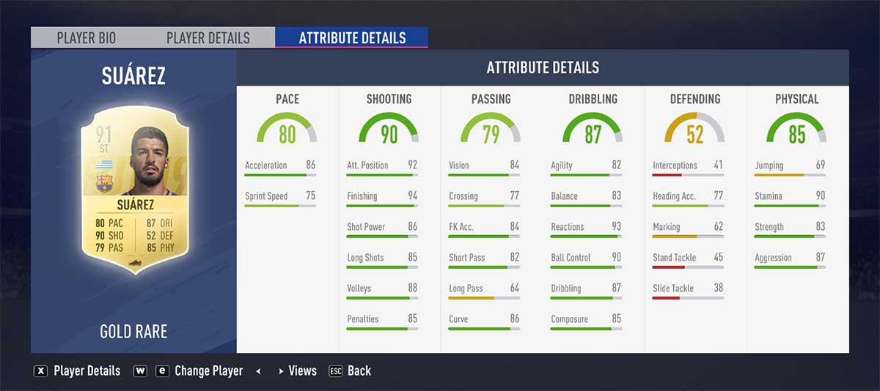
HOW DOES RATINGS FOR THE PLAYERS OF FIFA 22 LOOK LIKE -> EXAMPLE !

Slide 9
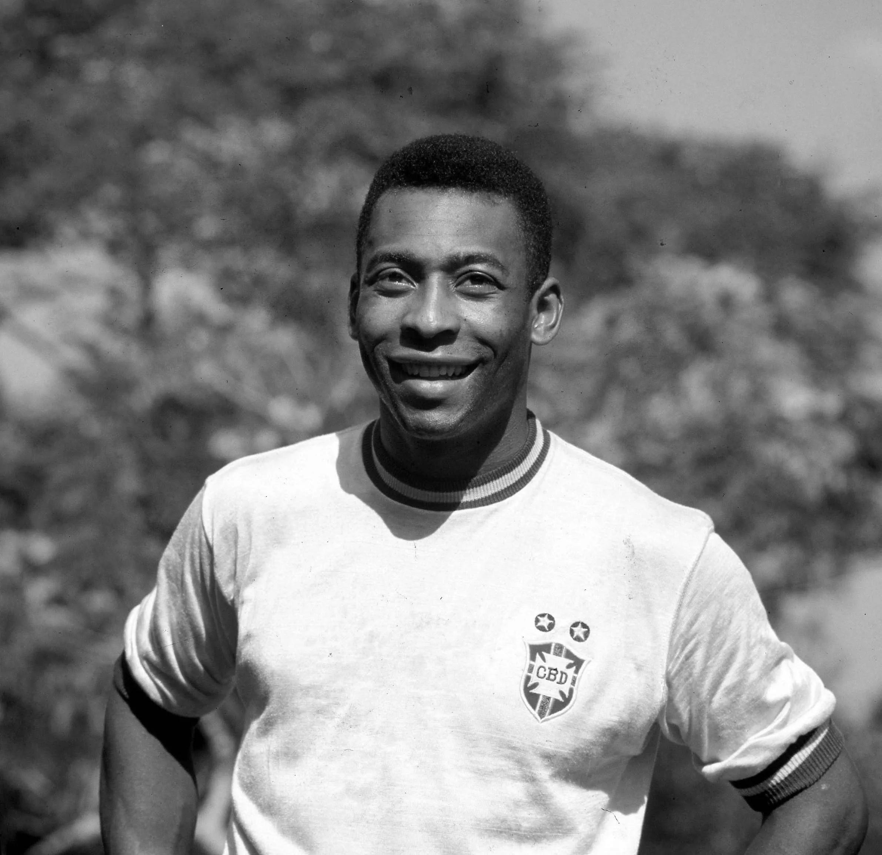

“SUCCESS IS NO ACCIDENT”
__EDSON PELE

Slide 10
DATA SUMMARY & PLOTS
Choosing of suitable variables from this large dataset of 16155 rows and 110 columns was a challenge
I took total of 10 variables ,
5 for each mentality and physicality aspect , and tried to find suitable regression set up for one variable of one group with all other variables of the Physical Attribute data frame .

Slide 11
DESCRIPTIVE PART
 | No. of variables | Mental Attributes | Physical Attributes
Character Variables | 48 | Aggression | Shooting
Logical Variables | 2 | Positioning | Passing
Numeric Variables | 58 | Interceptions | Heights and Weights
POSIXct | 2 | Vision and Penalty Approach | Pace

Slide 12
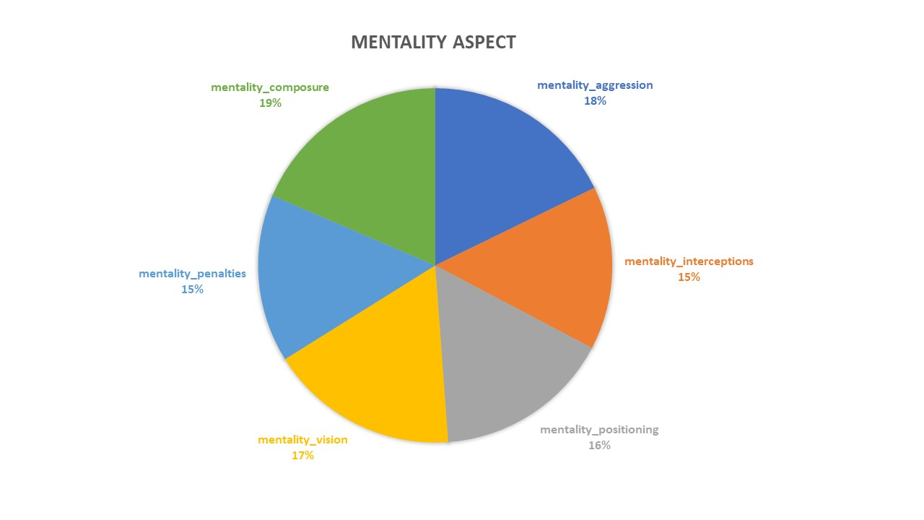
PIE-CHART
This initial chart presents the even distribution of Mental Attributes across the dataset , Boxplots and Histograms are also shown afterwards

Slide 13
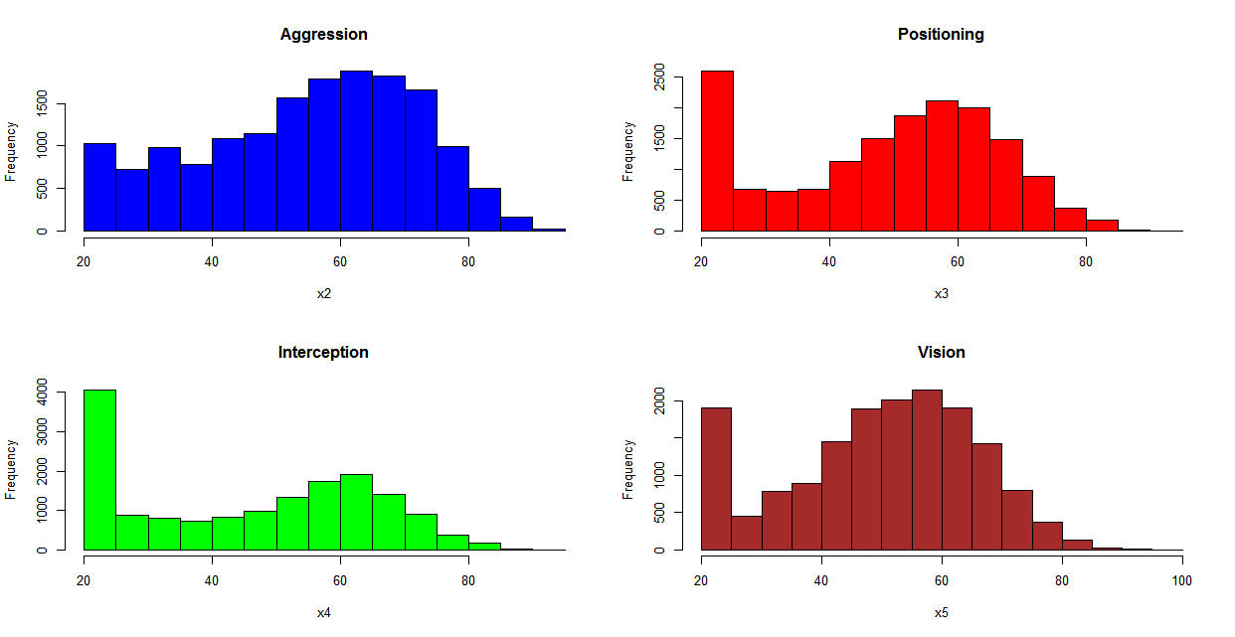
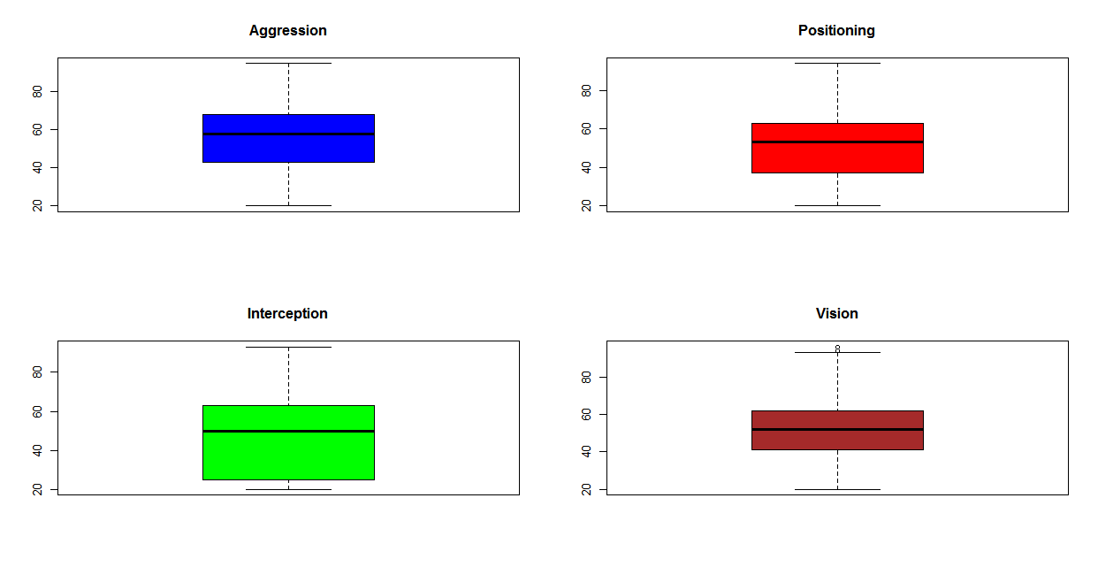
The four variables of the mentality aspects are more or less distributed as bell-shaped . Box-plots are also not showing much outliers in the Data-frame.

Slide 14
02
HEADING TOWARDS REGRESSION
Are the mentality attributes linearly related with the group of physical attributes or there is something more?

Slide 15
ASSUMPTIONS
1. Linear relationship
2. No Multicollinearity
3. Independence
4. Homoscedasticity
5. Multivariate Normality

Slide 16
RESULTS
Test -Statistic p-value
Shapiro-Wilk 0.9777 0.0000
Kolmogorov-Smirnov 0.0549 0.0096
Cramer-von Mises 59.6131 0.0000
Anderson-Darling 3.6367 0.0000
Considering the number of observations in our dataset (1000 as I reduced the dataframe and tested for the linear relationship on Vision), we should use the Kolmogorov-Smirnov test to examine the normality of the residuals. Because the p-value is below 0.05, we reject the null hypothesis and conclude that the residuals do not follow a normal distribution.
So our assumption of linear fitting may be inaccurate

Slide 17
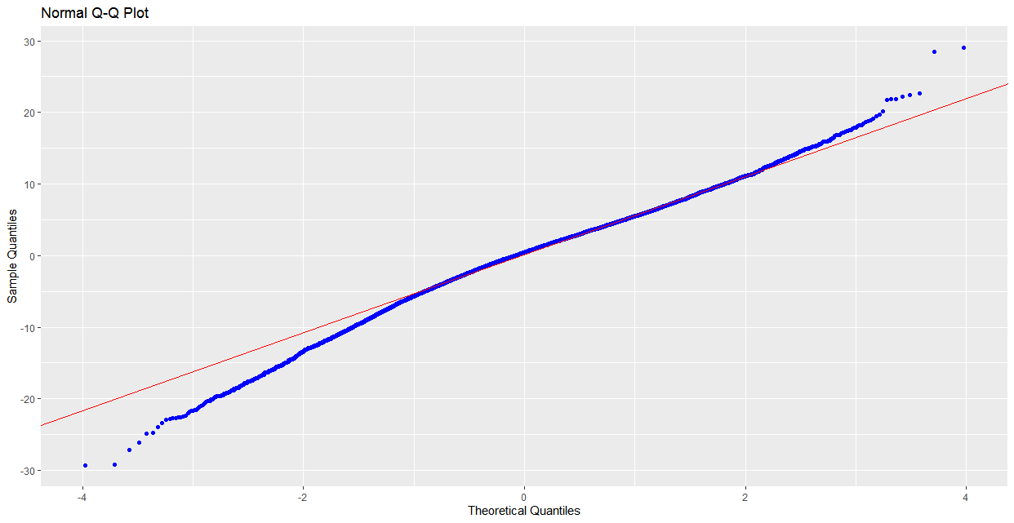
Then our model consists of non-normal residuals , but where is the linear model?

Slide 18
REGRESSION EQUATIONS OBTAINED
(Aggression) X₂ = -37.83846 -0.39035 X₁₄ + 0.72390X₁₅+ 0.20443 X₁₉ + 0.59839 X₂₀ -0.07603X₂₄
(Positioning) X₃ = 15.20392 +0.75042 X₁₄ + 0.19767X₁₅- 0.09942 X₁₉ - 0.05066X₂₀ +0.14711X₂₄
(Interceptions) X₄ = -28.3226 -0.9691 X₁₄ + 1.1335X₁₅+ 0.2653 X₁₉ + 0.3606X₂₀ -0.1436X₂₄
(Vision) X₅= 14.27561 +0.27441 X₁₄ + 0.81893 X₁₅-0.04304 X₁₉-0.08927 X₂₀ -0.08259 X₂₄
(Penalty Approach) X₆ = 29.50541 +0.73804 X₁₄ + 0.03882X₁₅-0.06526 X₁₉ + 0.01517 X₂₀ -0.09756X₂₄
In all of these models, the Adjusted-R² values are significantly less than usual values which appreciate linear relationship correctly.
R²_{adj}(X₂) = 0.2567 , R²_{adj}(X₃) = 0.7161 , R²_{adj}(X₄) = 0.4638
R²_{adj}(X₅) = 0.7815 , R²_{adj}(X₆) = 0.6035
So , linear regression for Vision on Physicality is most suitable here, with 71.61% linear explanation.
X₁₄ = Shooting , X₁₅ = Passing , X₁₉ = Weight , X₂₀ = Height , X₂₄ = Pace

Slide 19
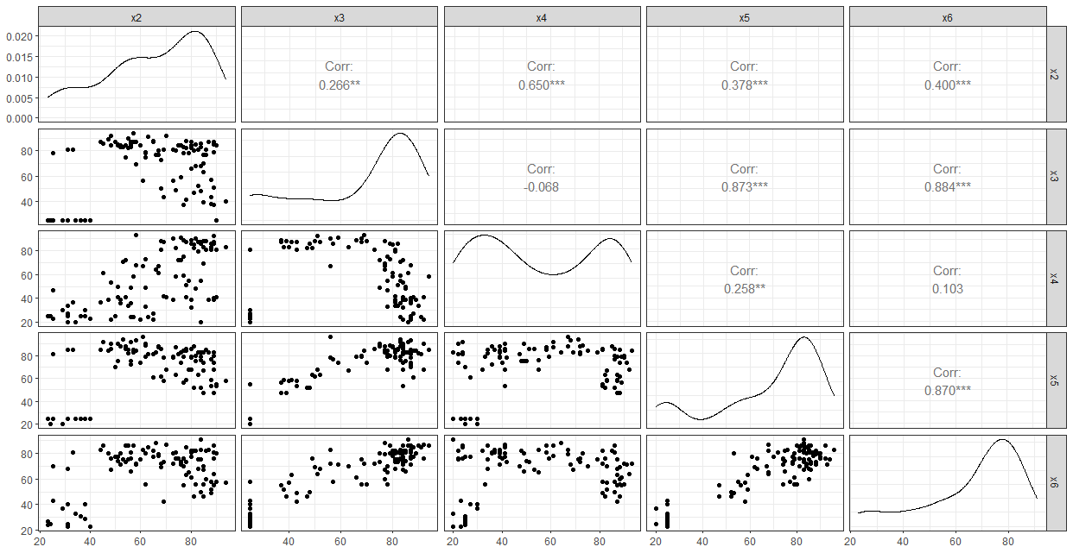
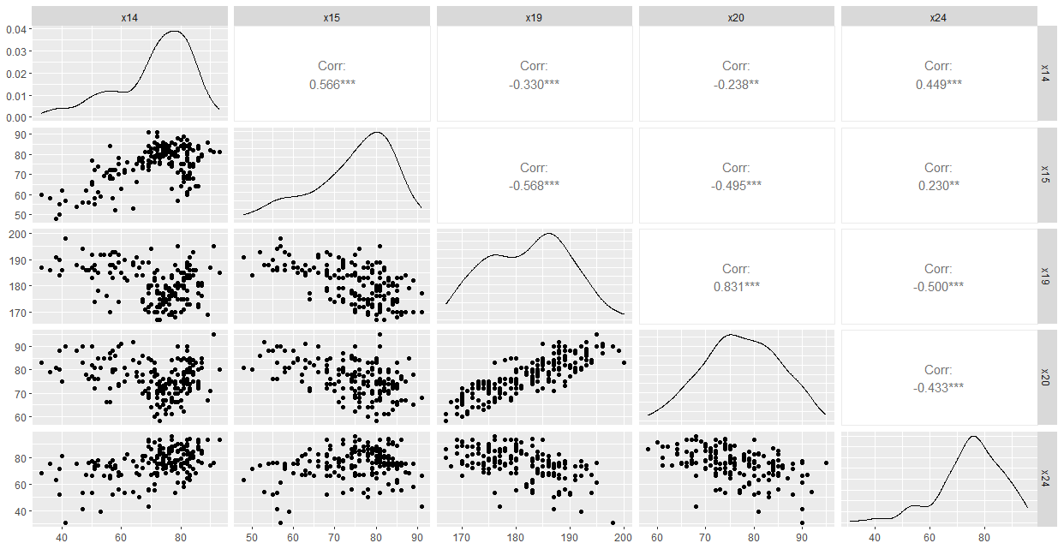
X₂ = Aggression X₃ = Positioning X₄ = Interceptions X₅ = Vision X₆ = Penalty Approach
SCHEDULE
10%
X₁₄ = Shooting X₁₅ = Passing X₁₉ = Weights X₂₀ = Heights X₂₄ = Pace

Slide 20
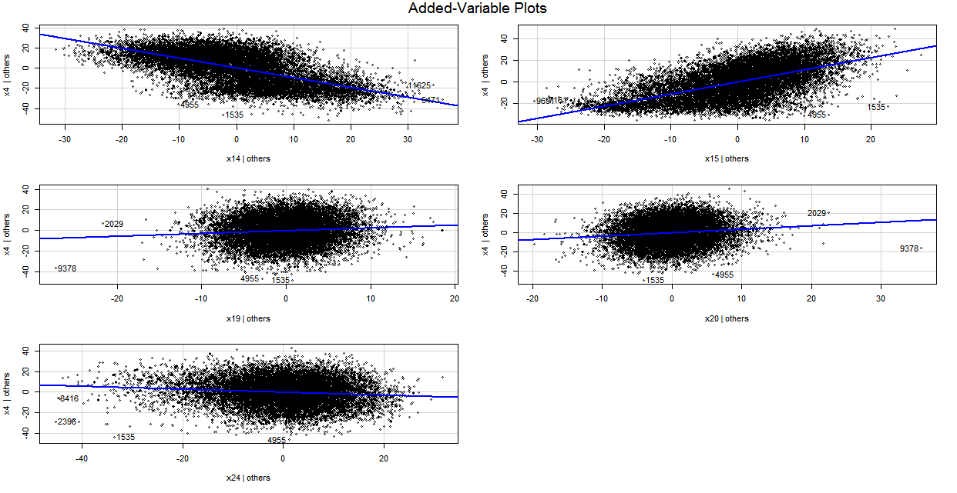
Multiple Regression line of Vision(X4) on Physicality , but is this linear regression acceptable?

Slide 21
THIS FOLLOWING R-CODE USING DIFFERENT COMBINATIONS OF MODELS WILL ANALYSE WHICH IS THE BEST SUITABLE MODEL !
M_P<-data.frame (x2,x3,x4,x5,x6,x14,x15,x19,x20,x24)
vision.mod1 <- lm(x5 ~ x14+x15, data = M_P)
vision.mod2 <- lm(x5 ~ x14+x24, data = M_P)
vision.mod3 <- lm(x5 ~ x24+x15, data = M_P)
vision.mod4 <- lm(x5 ~ x14+x15+x24, data = M_P)
vision.mod5 <- lm(x5 ~ x14*x15*x24, data = M_P)
models <- list(vision.mod1, vision.mod2, vision.mod3, vision.mod4, vision.mod5) model.names <- c(‘vision.mod1’,’vision.mod2’, ‘vision.mod3’,‘vision.mod4’,’vision.mod5’) aictab (cand.set = models, modnames = model.names)
Model selection based on AICc:
K AICc Delta AICc AICcWt Cum.Wt LL
vision.mod5 9 92433.44 0.00 1 1 -46207.71
vision.mod4 5 92449.10 15.66 0 1 -46219.55
vision.mod1 4 92571.56 138.12 0 1 -46281.78
vision.mod3 4 95195.29 2761.85 0 1 -47593.64
vision.mod2 4 104783.69 12350.25 0 1 -52387.84

Slide 22
WHAT IS “AIC” ACTUALLY ?
In simple words , AIC (Akaike Information Criterion ) determines the relative information value of the model using the maximum likelihood estimate and the number of parameters (independent variables) in the model.
So if two models explain the same amount of variation, the one with fewer parameters will have a lower AIC score and will be the better-fit model.

Slide 23
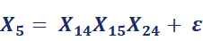
STRANGE ! THE MULTIPLICATIVE MODEL IS THE MOST SUITABLE MODEL , FROM AIC VALUE PERSPECTIVE ; VISION IS MEASURED ON THE BASIS OF SHOOTING ,PASSING AND PACE SKILLS

Slide 24

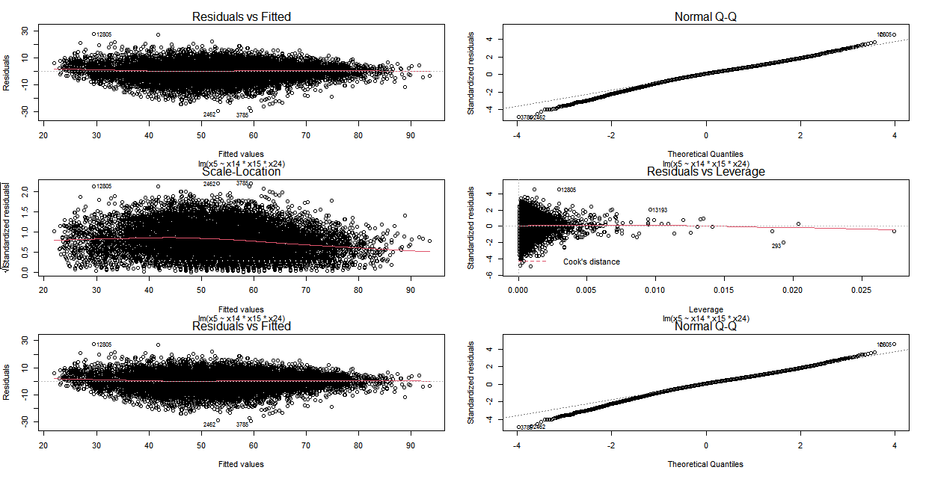
MODEL PLOTTING FOR THE PROPOSED NON-LINEAR MODEL

Slide 25
HYPOTHESIS TESTING
To test ,
H₀: β_{i} = 0 (the slope is equal to zero)
H_{A}: β_{i} ≠ 0 (the slope is not equal to zero) , for the model of VISION on Physical Attributes ;
We use
Estimate Std. Error t value Pr(>|t|)
(Intercept) -2.4046508 0.3610052 -6.661 2.819e-11 ***
Shooting 0.2673151 0.0048583 55.023 < 2.2e-16 ***
Passing 0.8324055 0.0059571 139.734 < 2.2e-16 ***
Pace -0.0550700 0.0049262 -11.179 < 2.2e-16 ***
Since the p-value for each t-test is less than .05 , we would say that Shooting , Passing and Pace are
such abilities that they are statistically significant predictors of Vision of a Soccer player

Slide 26
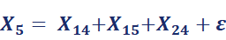
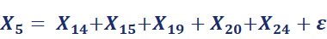
ANOVA OF MODELS
We have following two linear models for the dependent variable Vision .
MODEL-1 :
MODEL-2 :
Analysis of Variance Table
Res.Df RSS Df Sum of Sq F Pr(>F)
14376 521271
14374 513521 2 7750.1 108.47 < 2.2e-16 ***
As the p-value is <0.05 , we can conclude that the complex model with more variable is significantly better to explain the Vision of a player

Slide 27
F-TEST
Summary of the previous model is as follows.
Estimate Std. Error t value Pr(>|t|)
(Intercept) 14.275614 1.878532 7.599 3.16e-14 ***
Shooting 0.274410 0.004851 56.572 < 2e-16 ***
Passing 0.818926 0.005997 136.554 < 2e-16 ***
Weights -0.043036 0.012207 -3.526 0.000424 ***
Heights -0.089272 0.011635 -7.673 1.79e-14 ***
Pace -0.082594 0.005250 -15.732 < 2e-16 ***
Residual standard error: 5.977 on 14374 degrees of freedom
Adjusted R-squared: 0.7815
F-statistic: 1.029e+04 on 5 and 14374 DF, p-value: < 2.2e-16
The F-test for overall significance has the following two hypotheses:
The null hypothesis states that the model with no independent variables fits the data as well as your model.
The alternative hypothesis says that your model fits the data better than the intercept-only model.

Slide 28
F-TEST
As for the large value of degrees of freedom due to error , F_{obv} becomes very large . Also the p-value corresponding to the F-statistic is less than 0.05.Hence we reject the null hypothesis and conclude that the regression model for Vision is significant.

Slide 29
I usually go through the variables one at a time to try and develop questions and find answers to them. Considering this dataset had many variables, I only selected a few I thought would be interesting to find answers to
LET’S GO!

Slide 30
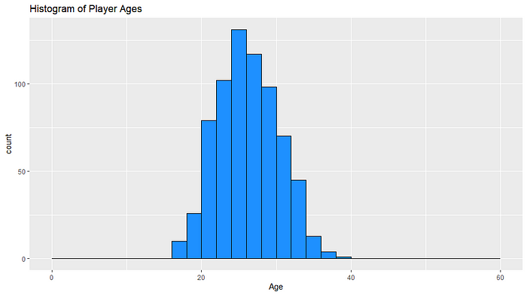
WHAT IS THE DISTRIBUTION OF PLAYER AGES?
KIND OF SYMMETRICAL DISTRIBUTION
I discovered that on average players in the game are about 27 years old.

Slide 31
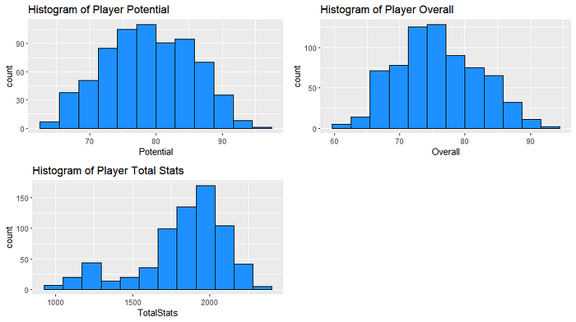
SYMMETRICITY CHECKING FOR POTENTIAL PLAYERS
the average overall rating of all the players is about 76. 1 , which is quite up to the mark. Potential of players is also Bell-shaped and symmetric

Slide 32
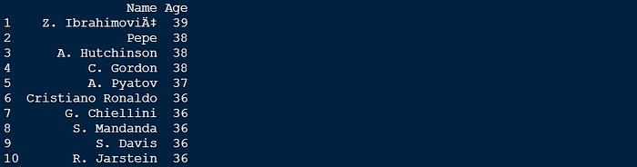
WHO ARE THE TOP TEN OLDEST PLAYERS IN THE GAME?
It did not come as a surprise that Cristiano Ronaldo was amongst the oldest players in the game. Not everyone can stay at the top level as long as he had!

Slide 33
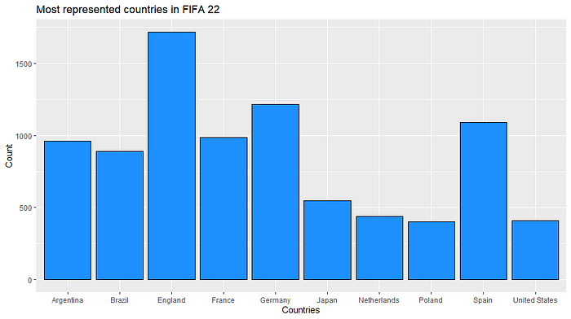
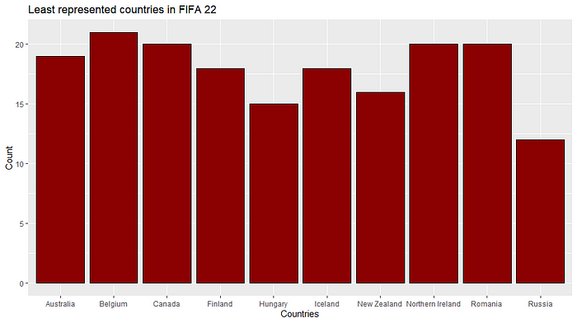
WHICH IS THE MOST REPRESENTED COUNTRY IN THE GAME ?
England was the most represented country in the FIFA 22. This might probably be due to the media coverage of the EPL(English Premier League). The least represented country was Russia in the game, I do believe a strong predictor of a country’s representation has to do with the media coverage of their respective leagues.

Slide 34
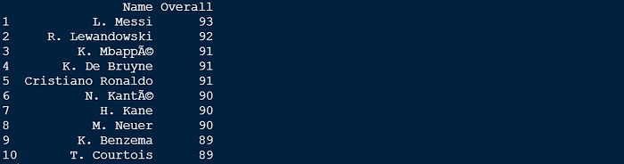
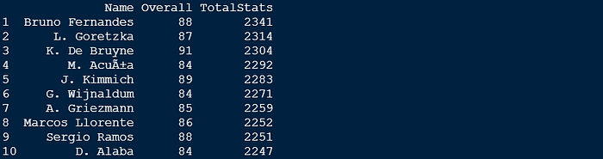
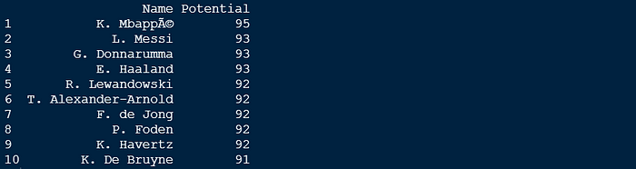
WHO IS THE BEST PLAYER?
In overall rating , Messi is the highest point player , Bruno Fernandez from Portugal is the highest “Totalstat” player . Kylian Mbappe is the player with most potetial in the game.

Slide 35
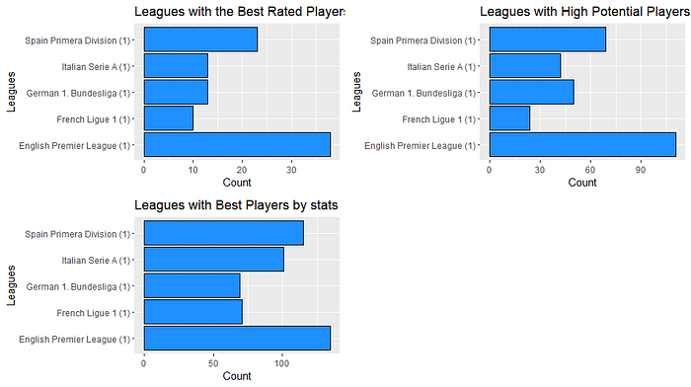
WHICH LEAGUE HAS THE BEST PLAYERS?
The EPL has the highest-rated players, this makes me wonder if the other leagues have worse players or if the English media coverage aids with the international recognition factor when rating the players.

Slide 36
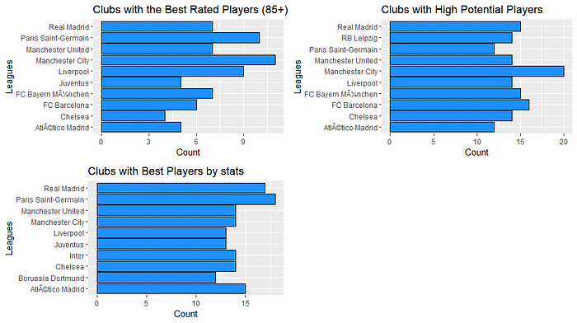
WHICH CLUB HAS THE BEST PLAYERS?
Manchester City appears to have the best rated players, as well as the players with the highest potentials. However, surprisingly, the best players by total stats come from Paris Saint-Germain and Real Madrid. I would assume Paris Saint-Germains would be the highest due to their very much successful transfers.

Slide 37
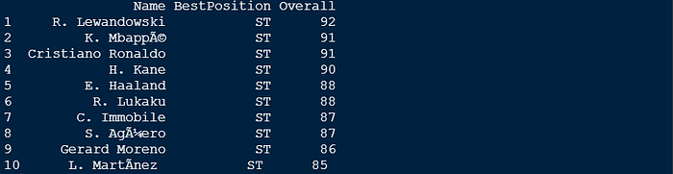
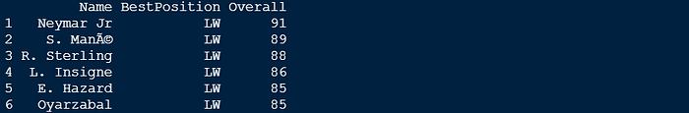
BEST PLAYERS BY POSITIONING
After joining the data set, I removed the unwanted columns and renamed a few columns to make the manipulation more consistent .
There are surprisingly
not a lot of top-rated LW
players since there
were just 6 players
who reached 85+. The same analysis goes for RW’s as the number of Wing Players involved in the whole game is rare .

Slide 38
KEY TAKEAWAYS
UNDERSTAND LARGE DATA
INTERPRETATIONS ONLY BY PLOTS
REGRESSION TECHNIQUES IN MULTIVARIATE SYSTEM

Slide 39
THANKS!
DO YOU HAVE ANY QUESTIONS?
ACKNOWLEDGEMENT
I am indebted to so many people for helping me in the preparation of this
project. I owe a deep debt of gratitude to my supervisor Dr. Debashis Chatterjee for necessary guidance . Special thanks to Dr. Sudhansu Sekhar Maiti, Head of the Department of Statistics, Visva Bharati University. I am greatly indebted to Dr. Arindam Chakraborty ,
Dr. Tirthankar Ghosh, Dr. Saran Ishika Maiti, Dr. Soumalaya Mukhopadhyay, Dr. Sourav Rana; Faculty members
often took pain and stood by me in adverse circumstances.
THANK YOU
sayantansinha987@gmail.com
+91 6294940293
SAYANTAN SINHA [B.Sc(Sem-VI)Stat-10]
Department of Statistics
Visva-Bharati University

